Slide 1
2024 SEA BASE REGISTRATION WALKTHROUGH
Preparing for a fair-weather sign-up experience

Slide 2
BEFORE JANUARY 18, 2023 (OPENING DAY)
REVIEW THE HIGH ADVENTURE REGISTRATION CHECKLIST
1
REVIEW SEA BASE’S ADVENTURE OFFERINGS
2
CONFIRM THE REGISTERING LEADER CAN LOG INTO MY.SCOUTING WITHOUT DIFFICULTY
5
DISCUSS YOUR UNIT’S AVAILABILITY AND MOST POPULAR ADVENTURE OPTIONS
3
KNOW ROUGHLY HOW MANY ADULTS AND YOUTH ARE PLANNING TO ATTEND
4

Slide 3
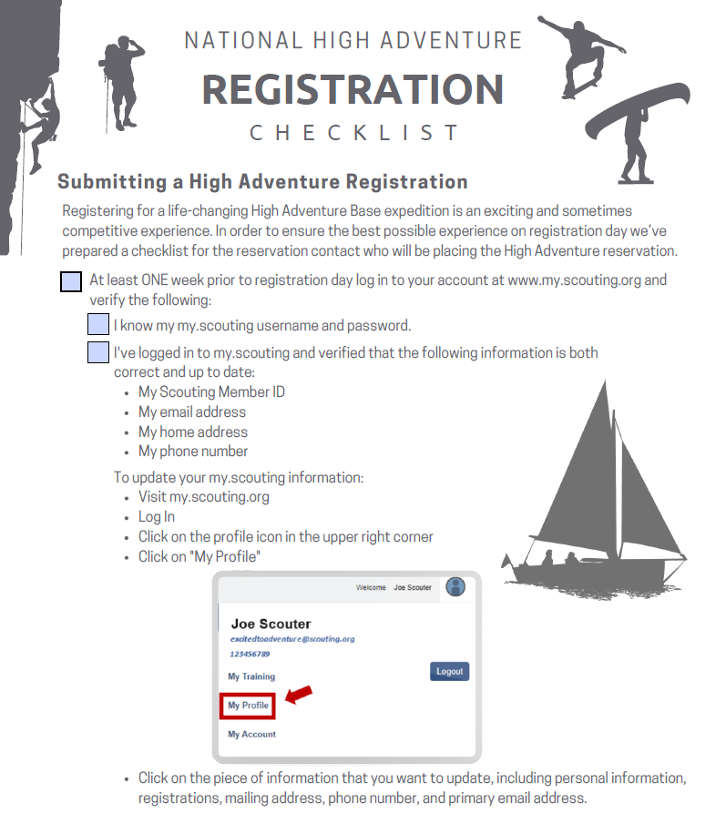
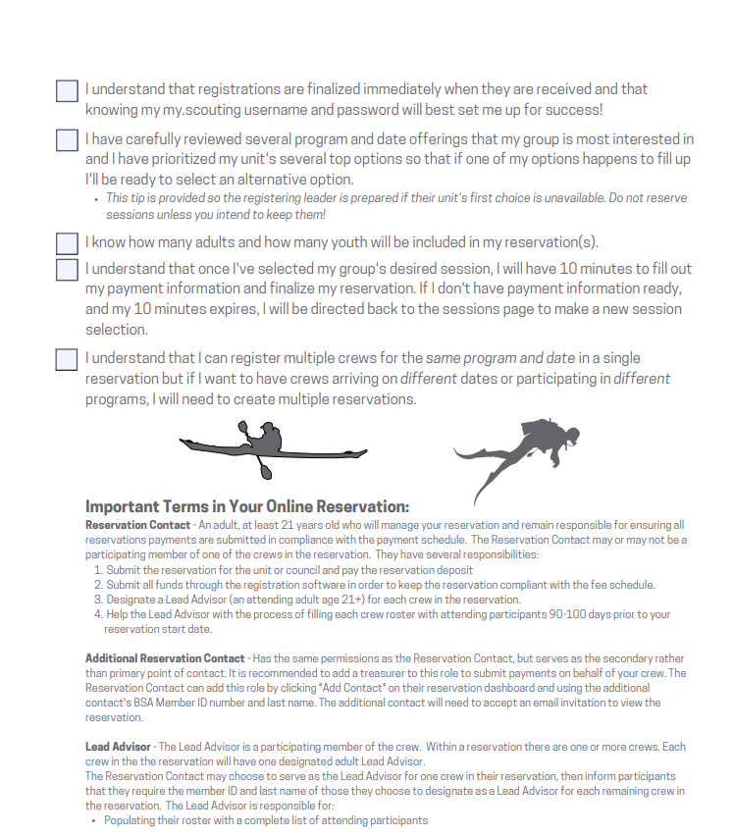
This checklist can be found on our 2024 Register Page

Slide 4
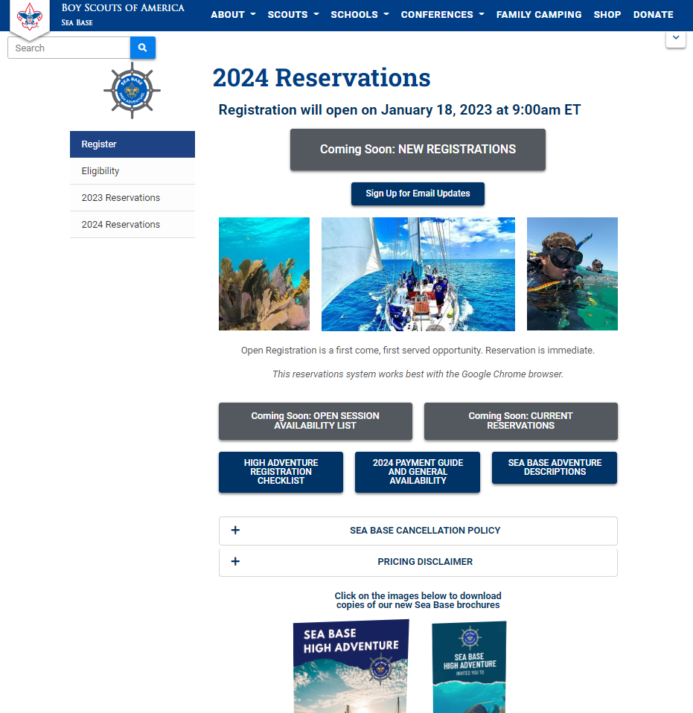
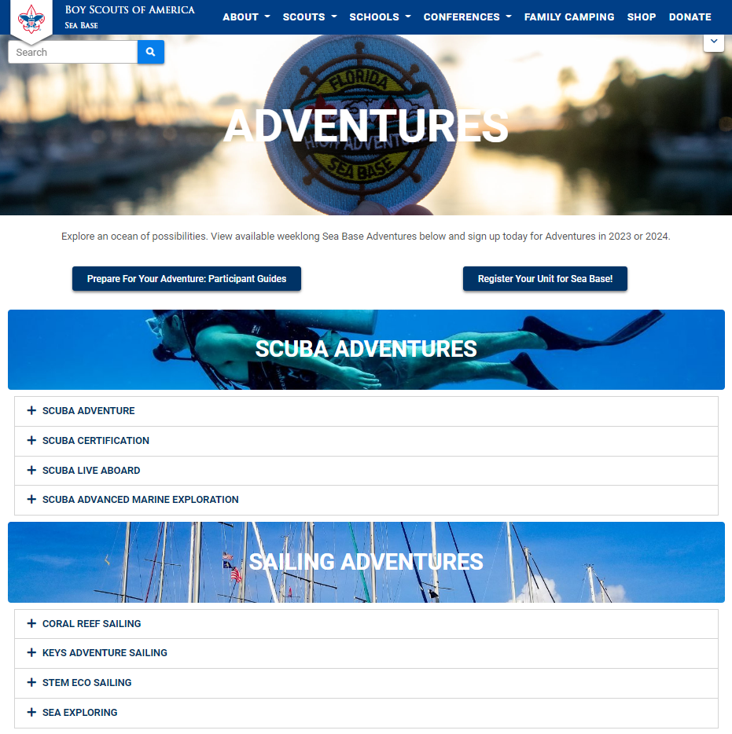
The Sea Base Website www.bsaseabase.org

Slide 5
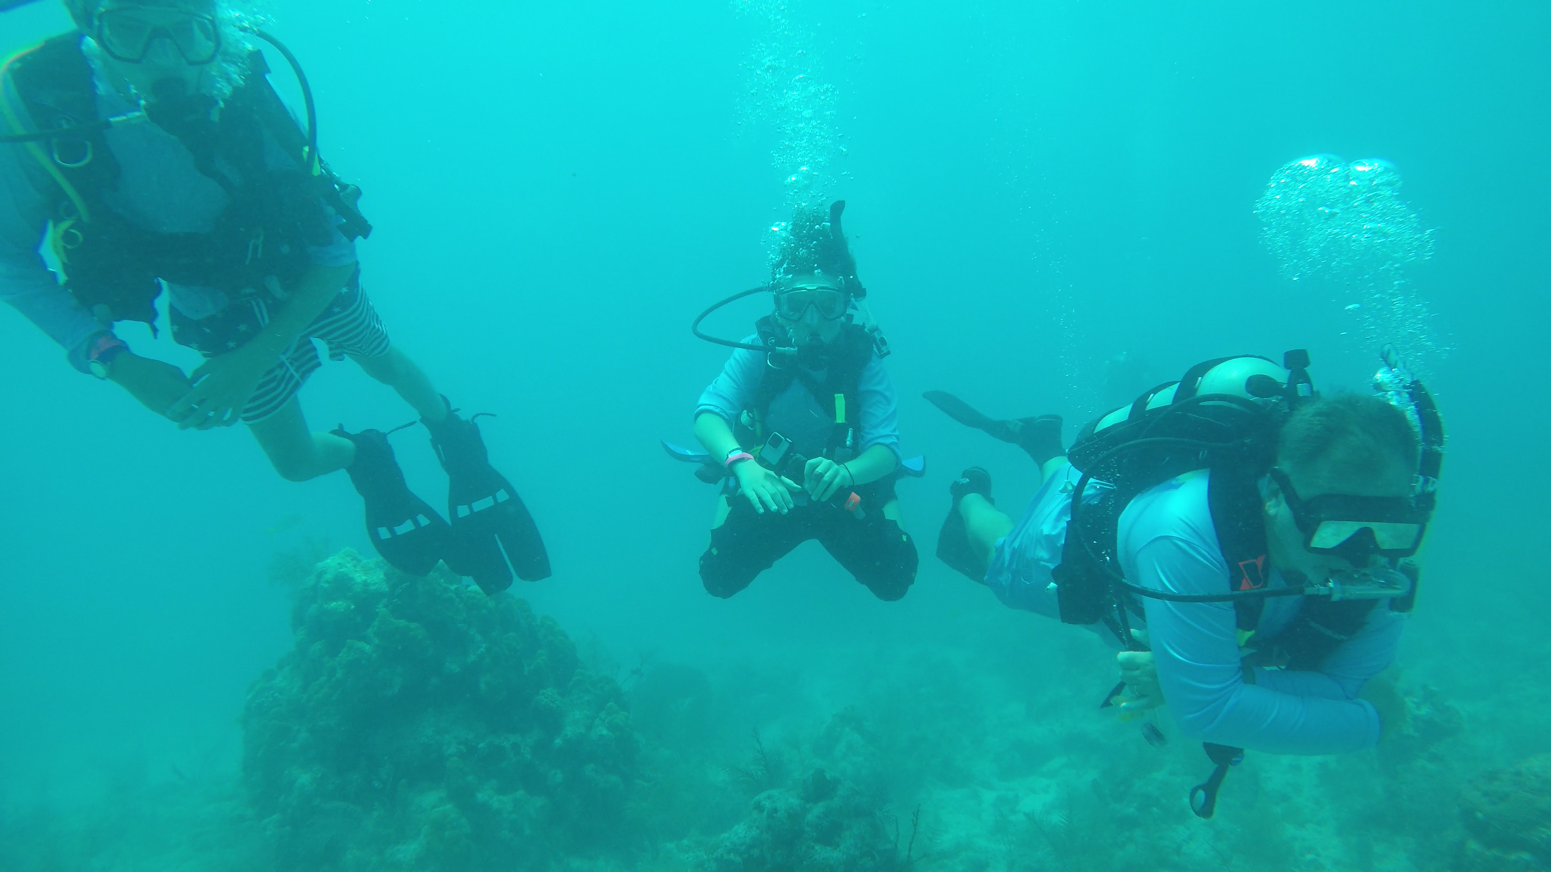
ON JANUARY 18, 2023
Register for 2024 Sea Base Adventures!

Slide 6
Notes Before Getting Started
This reservations system works best with the Google Chrome internet browser.
This reservations system is not mobile- friendly. Do not try to create a reservation or submit payment using your smartphone or tablet device.
Make sure the person reserving has a reliable internet connection.

Slide 7
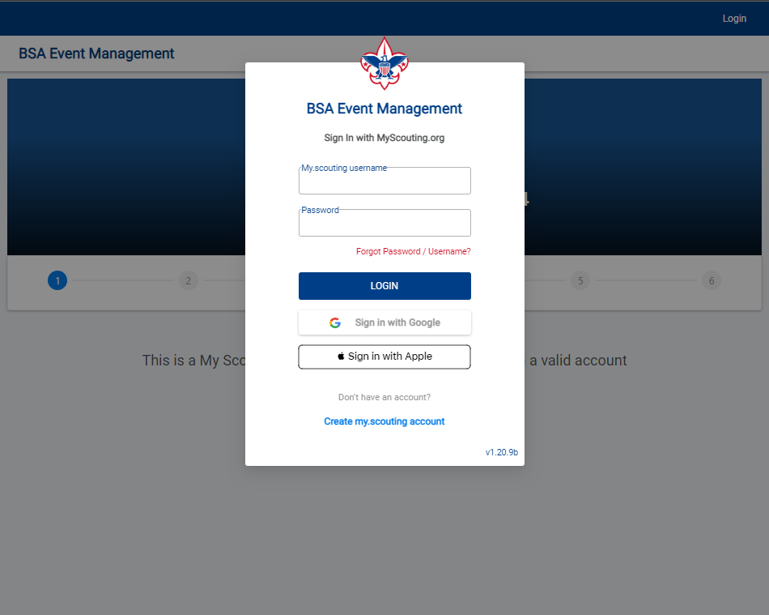
Log in using your My.Scouting account credentials
This is the page you will be directed to when you click on the “Book Now” or “New Reservations” buttons on our website.
Use your my.scouting credentials to log in to the reservations system, and click “LOGIN”.
If you have forgotten your password, use the “Forgot Password/Username” feature through my.scouting before registration opening to make sure sign up will go smoothly.

Slide 8
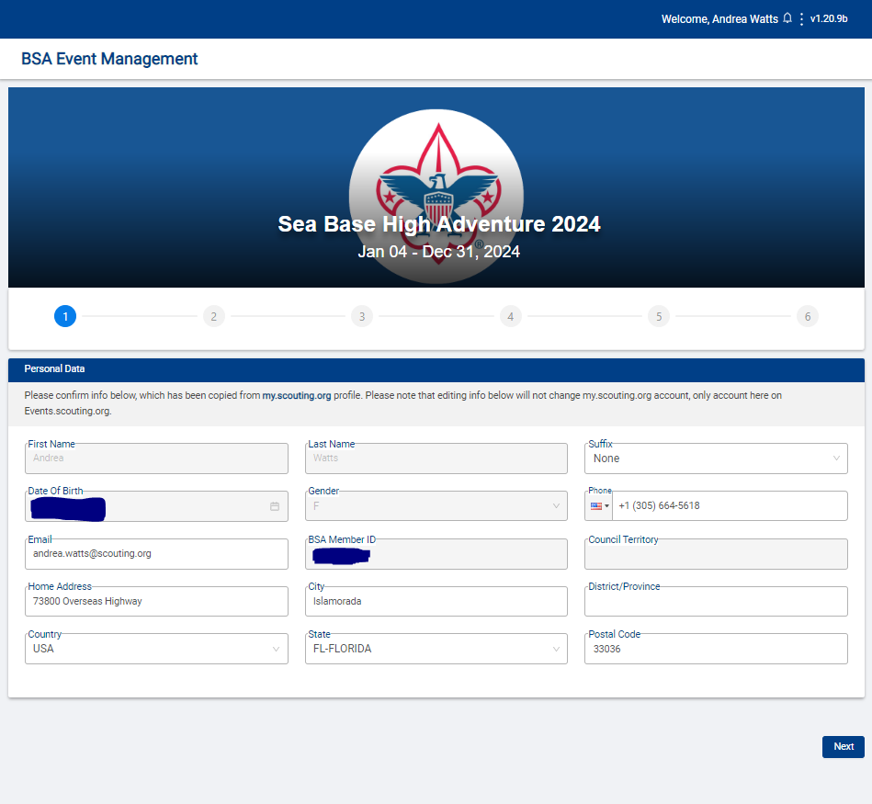
Confirm your Personal Information
This information is pulled from the profile on your my.scouting account.
You can update incorrect information before registration on January 18th by logging into my.scouting.org and editing your profile.
You can also edit fields at this step if they are not grayed out

Slide 9
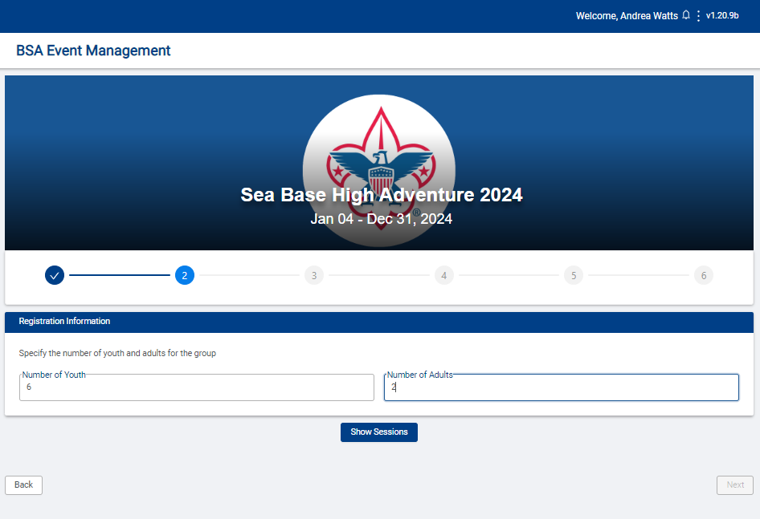
Input the Number of Youth and Adults Attending
These numbers do not need to be exact. The reservations system is using this input to determine the adventures available for you to reserve.

Slide 10
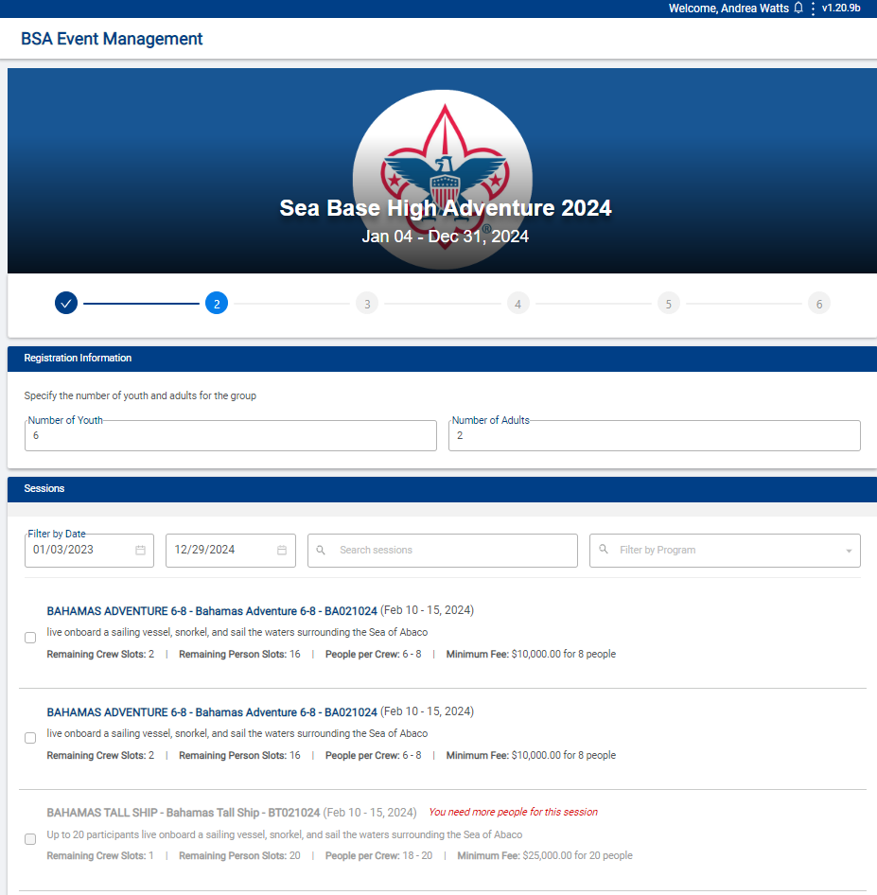
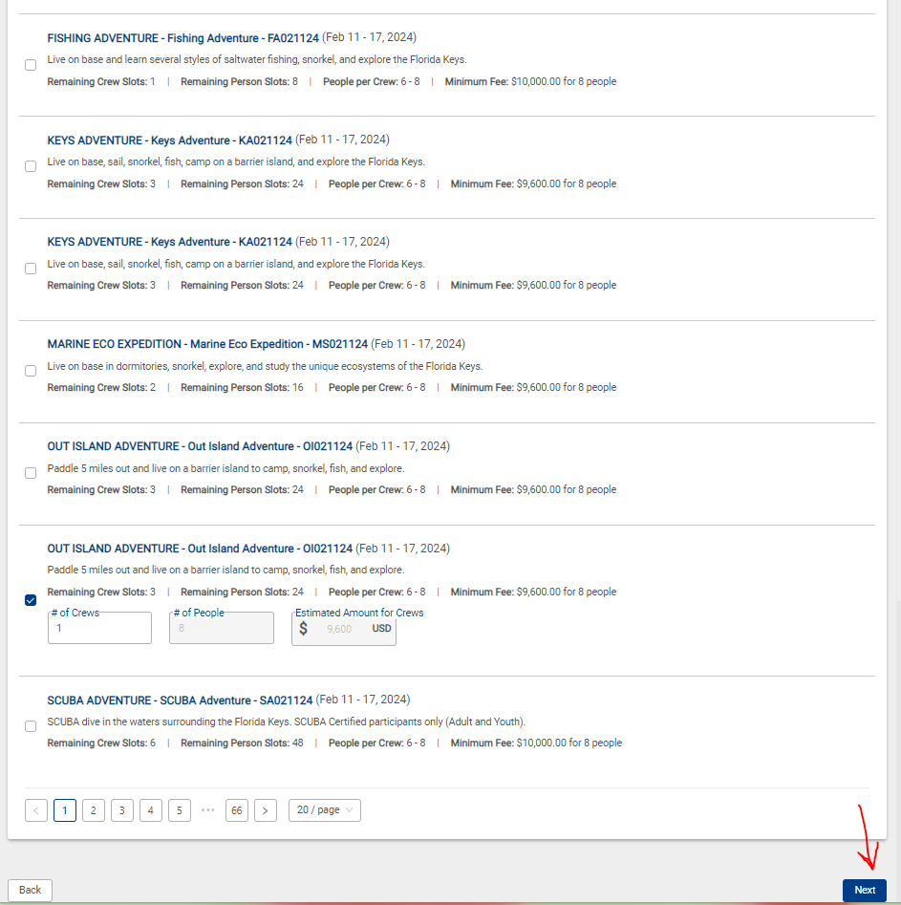
Finding & Selecting your Session
Sessions are sorted in date order, then by program name alphabetically.
Sea Base has more than 2,000 offerings
You can narrow the results by:
Selecting a date range
Searching for key words
Selecting programs to display
You can edit the number of youth and adults you have input at this step
The “Next” button is at the bottom of the page.

Slide 11
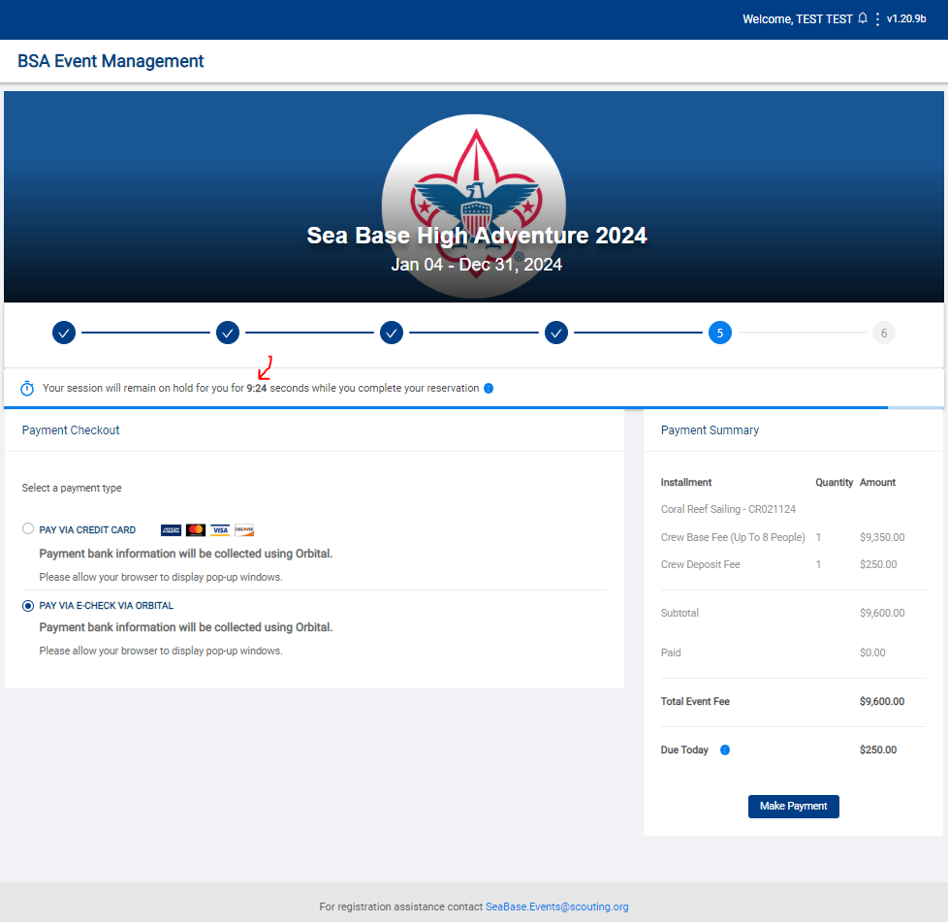
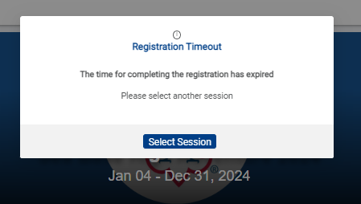
Finishing your Reservation
Once you move on to this step, you will have 10 minutes to complete the reservation
A non-refundable $250 deposit per crew selected is required to make the reservation.
The initial deposit can be made by credit card or ACH/Electronic Check.
The only online payment method offered for future payments will be ACH/E-Check

Slide 12
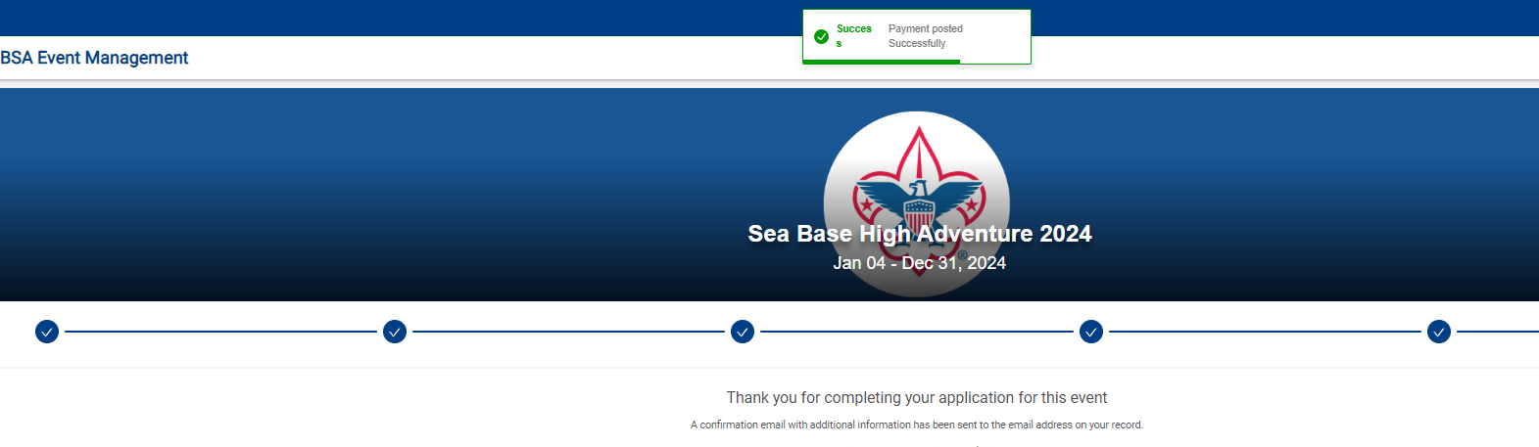
Success!
You should receive a confirmation email and payment receipt to the email address you confirmed in the first step, as well as a “Disclaimer Invite”
The “Disclaimer Invite” is a statement of understanding of our payment structure and other elements of High Adventure program. All members added to the reservation regardless of attendance should fill out a disclaimer.

Slide 13
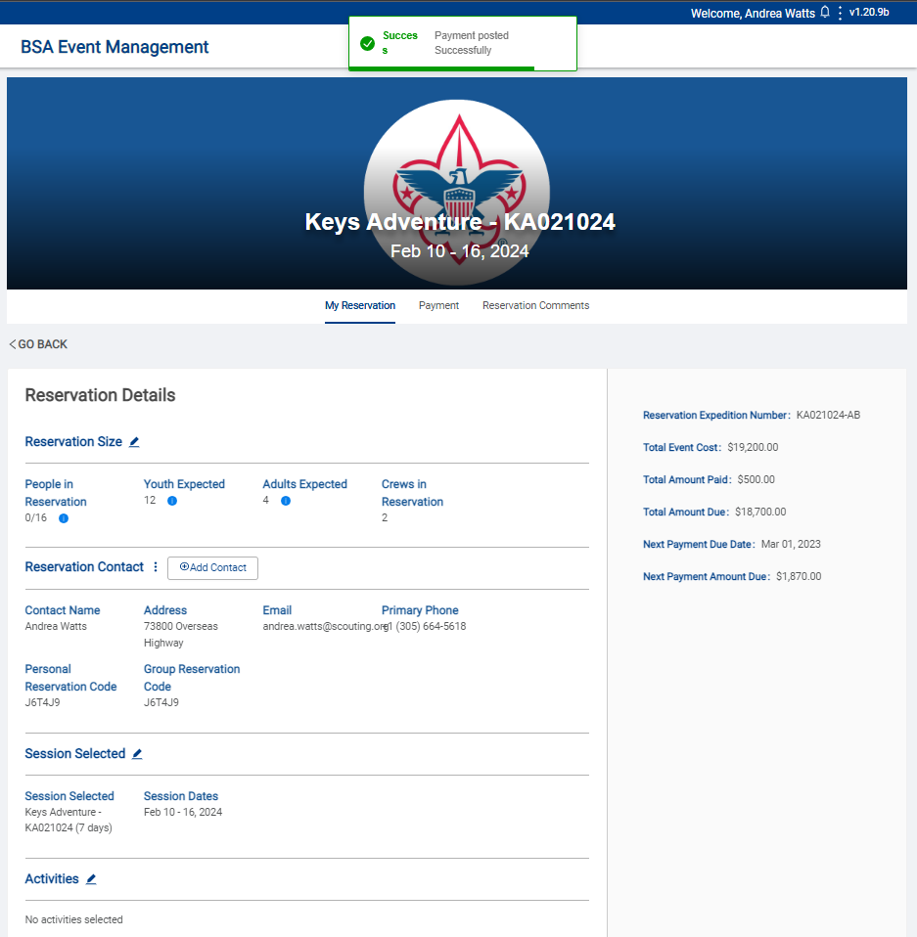
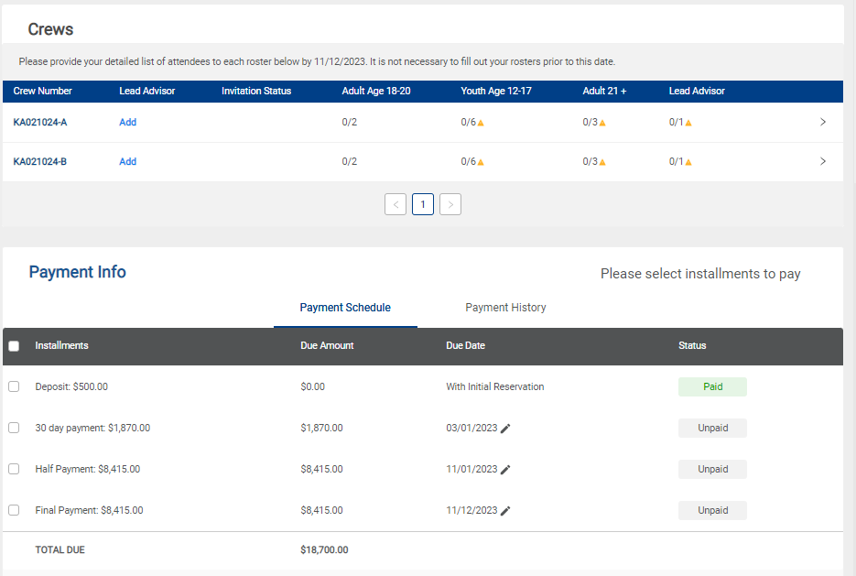
Reservation Dashboard
Your Reservation Dashboard is a page you can log into to view your reservation, payment history, etc. at any time through the Sea Base website.
You should be immediately redirected to the dashboard once your reservation is complete.

Slide 14
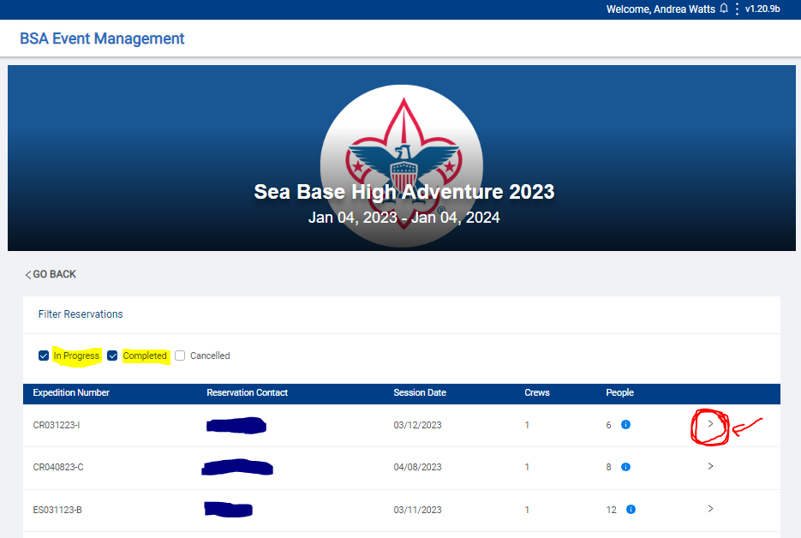
Accessing the Dashboard After Registration
The dashboard is available through our 2024 Crews Page by clicking on the button for “Current Reservations”, and logging in to your my.scouting account.
Once logged in, you will see a list of your reservations
To navigate to the reservation dashboard, click the gray arrow “>”

Slide 15
SEA YOU IN 2024
!

